Slide 1

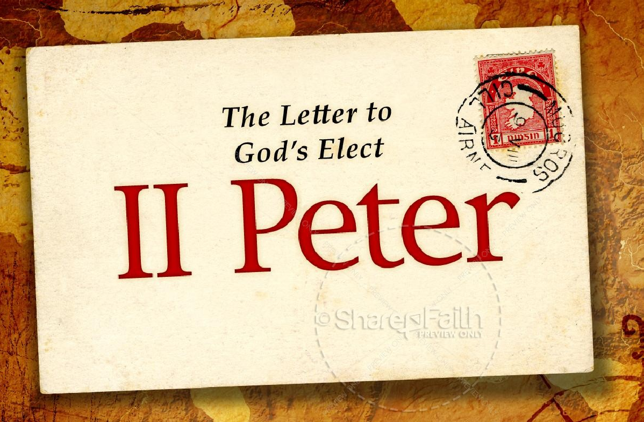
Growing in Holiness
in Light of the Promised Blessed Hope of the Lord and Savior’s Soon Return
Notes:
This is our goal, to grow in holiness—to be every day more conformed to the image of Christ. This has always been our goal. There has not been a time since I have been here that this has not been our goal. And as far as I know it ought to always be our goal. The question is, how to we do that? First of all, amongst other things we must be firmed rooted in the prophetic promises of God’s word. We must hold fast/stand in the “blessed hope” of the return of our Lord and Savior Jesus Christ.
Last week we discovered though that there is opposition to this goal.

Slide 2
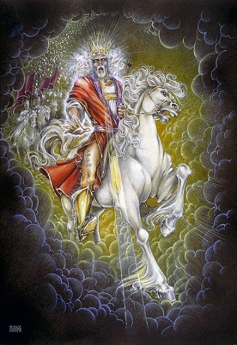
Growing in Holiness
2 PETER
The Coming of False Teachers -
“…there will be false teachers among you, who will secretly bring in destructive heresies, even denying the Lord who bought them, and bring on themselves swift destruction. And many will follow their destructive ways…” (2:1-2a)
Notes:
False teachers are real. False teachers are amongst our churches today in America. In fact they have been here for awhile. Let me begin today by giving you some real life examples of some false teachers who have been among us in America.

Slide 3
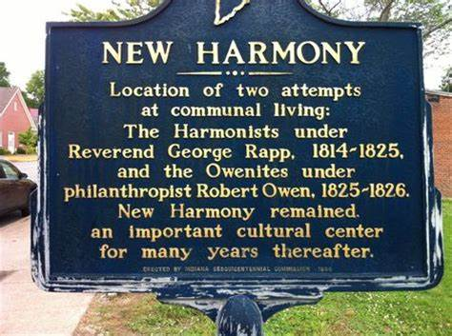
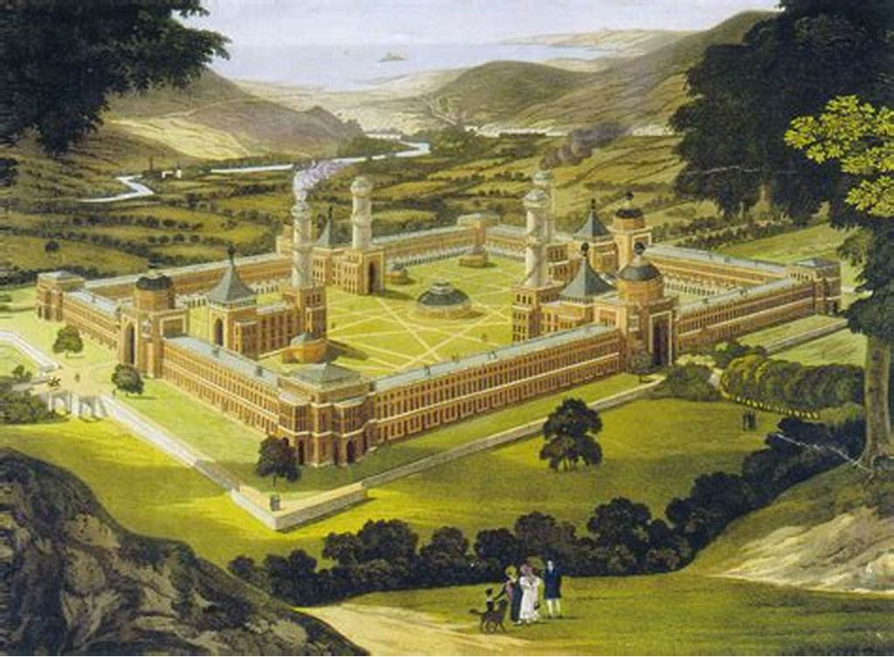
Growing in Holiness
2 PETER
George Rapp
Robert Owen
Harmony Society
Letting Loose of the Hope of Christ’s Coming
Notes:
The Harmony Society or the Harmonites founded by Johann Rapp and Robert Owen, in 1814 attempted to establish an communal utopia socialist society in Harmony, Pennsylvania, and then in New Harmony, Indiana. Owen at first was a deist, who later became a spiritualist. Their purpose was to establish a community to prepare by purifying themselves for the Coming of Christ, which they believed would come in their lifetime after the tribulation. They believed in perfectionism, unmarried celibacy, and practiced Christian mysticism.
We do need to prepare ourselves for the coming of Christ, but He is not coming after we have reached perfection. Anybody who thinks they can become perfect in this life is deluded, and make God out to be a liar.

Slide 4
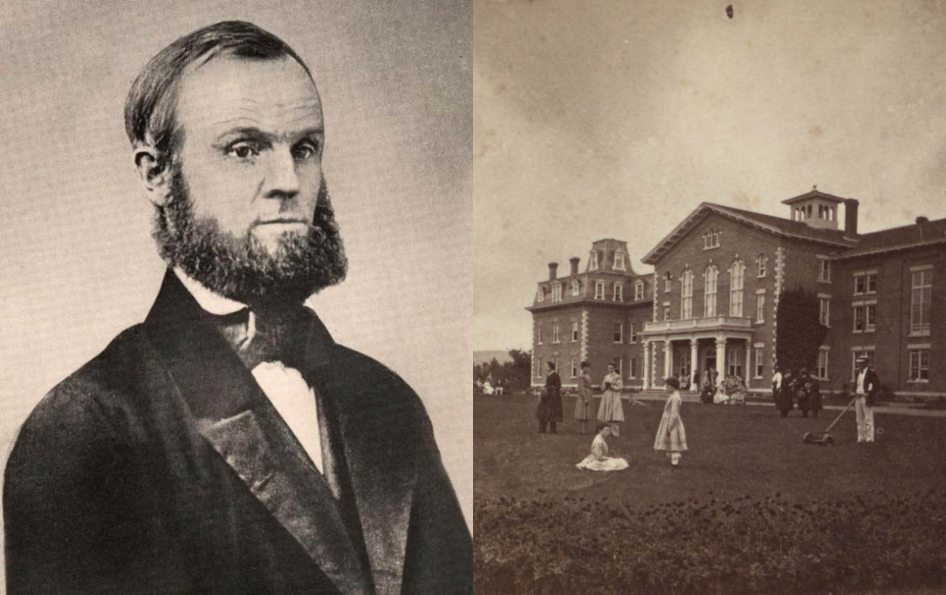
Growing in Holiness
2 PETER
John Humphrey Noyes
Letting Loose of the Hope of Christ’s Coming
Notes:
The Oneida Community was a perfectionist religious communal society founded by John Humphrey Noyes in 1848 in Oneida, New York. While at Yale college Noyes became a preterits, believing that Christ has return already in AD 70 and that mankind was now living in a new age. Since we are in the Kingdom, he believe they could create a perfect utopian society. Everything was supposedly held in common, including each others wives. They practiced “free Love” or what Noyes termed “complex marriage”. Noyes, as the leader, reserved the young virgins for himself. This went on for some 20 years until the local pastors in the area got the local authorities to charge him with statutory rape. After being warned of his impending arrest, he fled to Canada, and later died there.

Slide 5
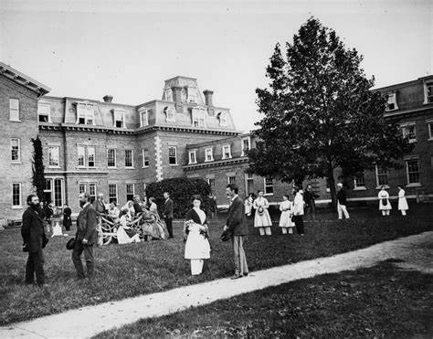
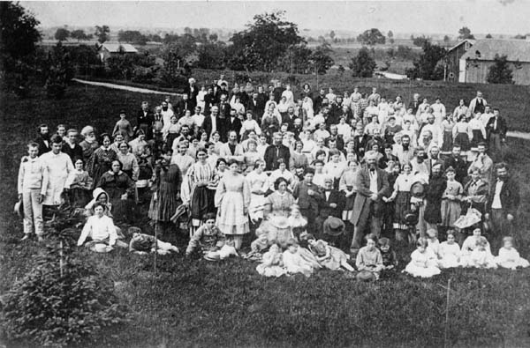
Growing in Holiness
2 PETER
Oneida Community
Letting Loose of the Hope of Christ’s Coming
Notes:
There will be many false teachers and many will follow them. Don’t be fooled by their fine dress.

Slide 6
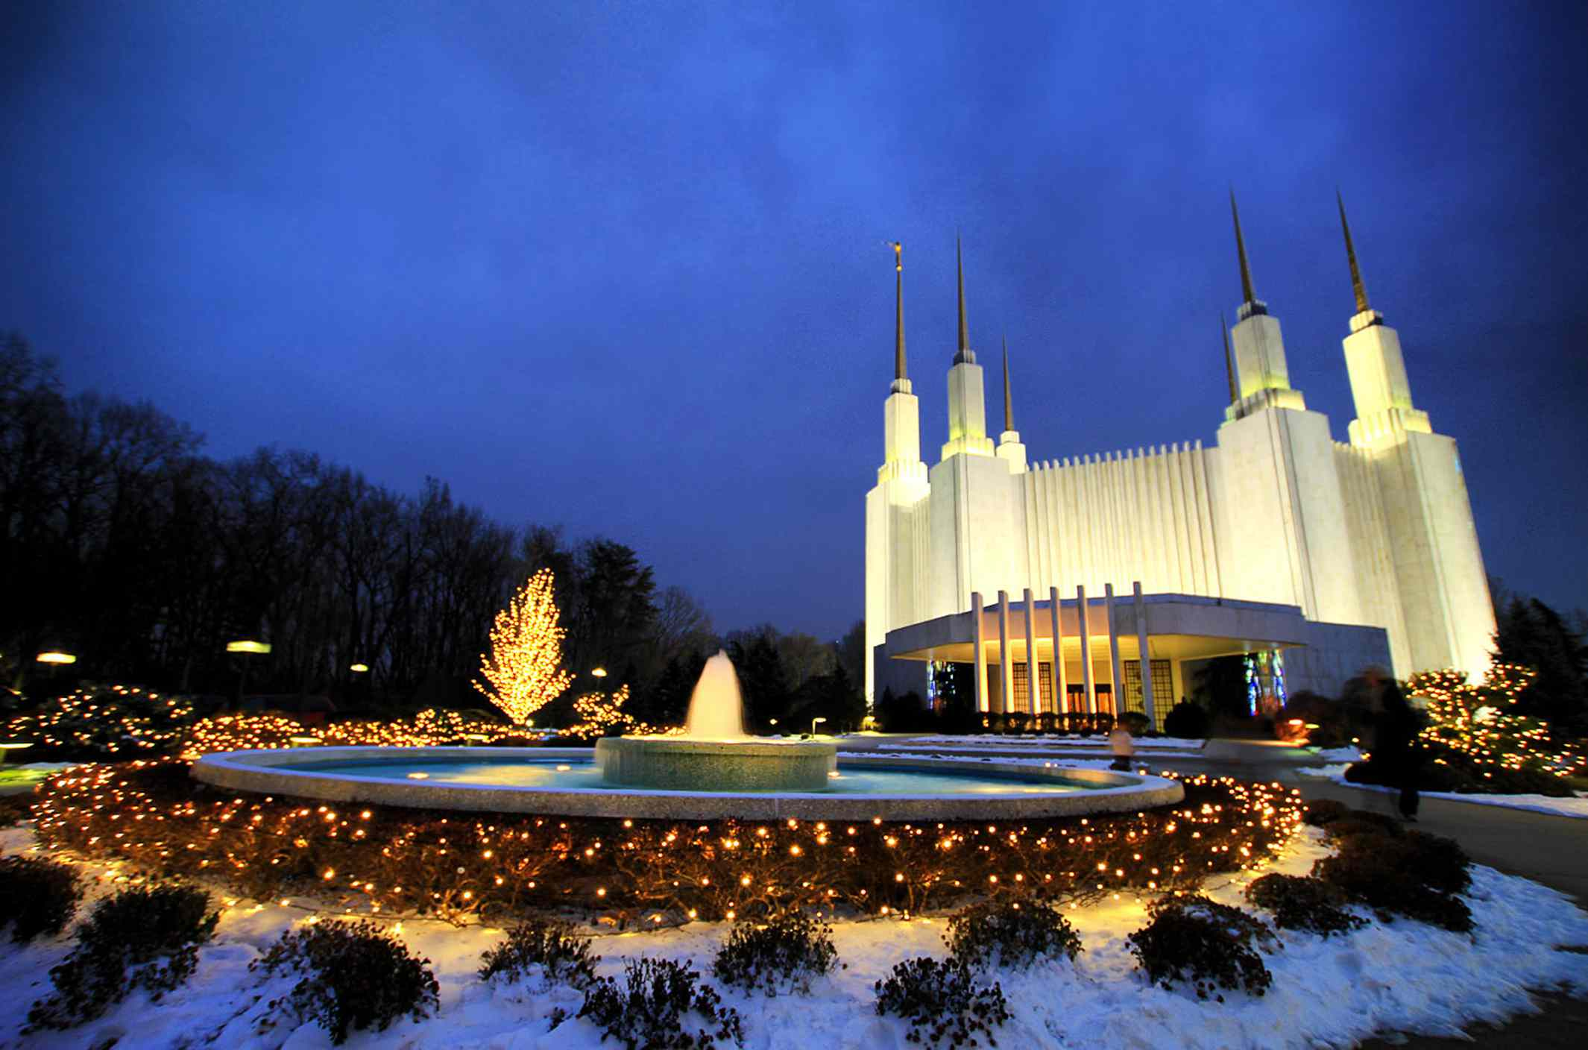
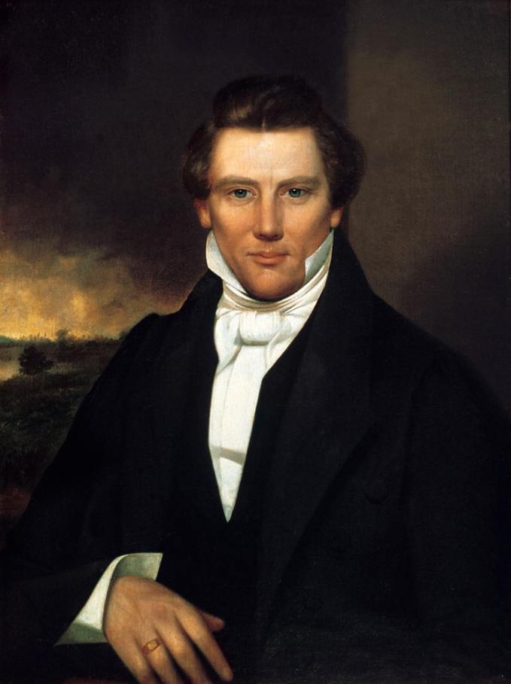
Growing in Holiness
2 PETER
Latter Days Saints
Joseph Smith
Letting Loose of the Hope of Christ’s Coming
Notes:
The Latter Days Saints, Mormonism, do not believe in the return of Christ to this earth. They believe that the earth is just one of many inhabited worlds, with many governing heavenly bodies—gods. Mormonism is classified as a spiritualist religion. They believe in continual revelation, and modern day prophets. They have a distorted view of marriage and originally practice polygamy, as some Mormon groups still do today.

Slide 7
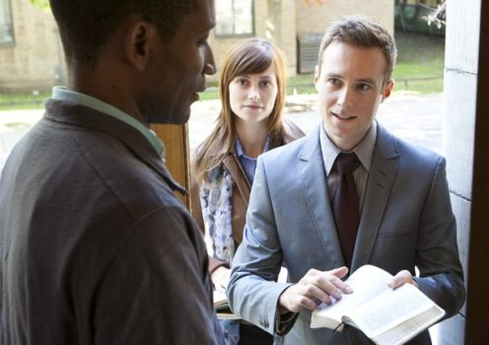
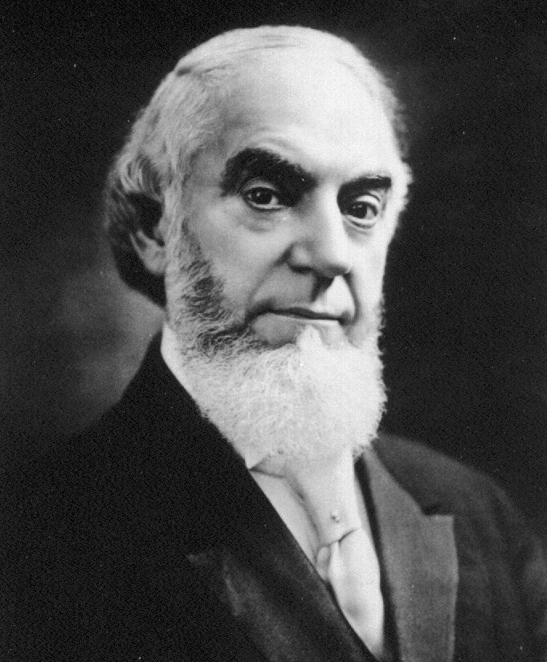
Growing in Holiness
2 PETER
Charles Taze Russell
Jehovah’s Witnesses
Letting Loose of the Hope of Christ’s Coming
Notes:
Jehovah’s Witnesses do not believe in a physical return of Christ. Why? Christ does not presently possess a physical body, but is an immortal spirit. JW’s believe that Christ already returned spiritually in 1874. They do not hold fast in the hope of Christ’s Coming, but look only to the establishment of the Millennial Kingdom preceded by Armageddon. Only those who rigorously meet the proper standards . . . are given the opportunity to prove themselves righteous by maintaining a favored status before God. (Ankerberg, p.150). Only the 144,000 live in heaven. Only those who maintain a righteous lifestyle will live on the new earth, they call paradise. Everyone else’s soul is annihilated. They cease to exists.

Slide 8
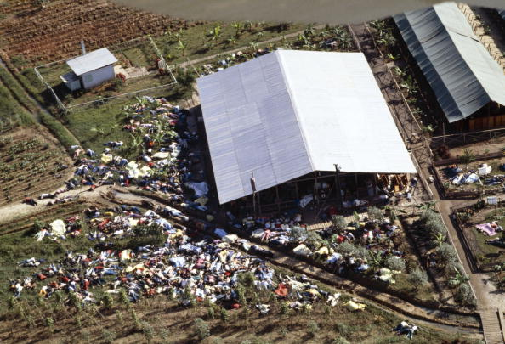
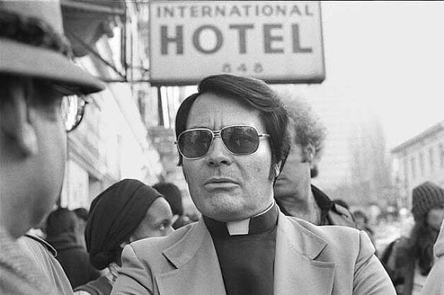
Growing in Holiness
2 PETER
People’s Temple
Jim Jones
Letting Loose of the Hope of Christ’s Coming
Notes:
James Warren Jones was a American civil rights preachers, faith healer, a communist, and the founder of the People’s Temple in the 1950’s. He hoped to create a “socialist paradise”. He was a self proclaim messiah and promised his followers utopian if they followed him. Though Jones discouraged sex and romantic relationships, He and others had several adulterous relationships including homosexual encounters. It ended with the death by mass suicide of some 900 men, women and children, in Jonestown, Guyana in November 1978, by drinking the Kool aid.

Slide 9
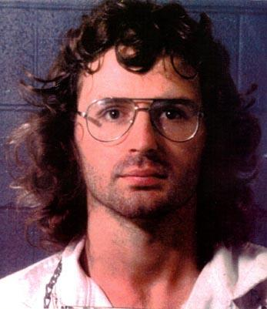
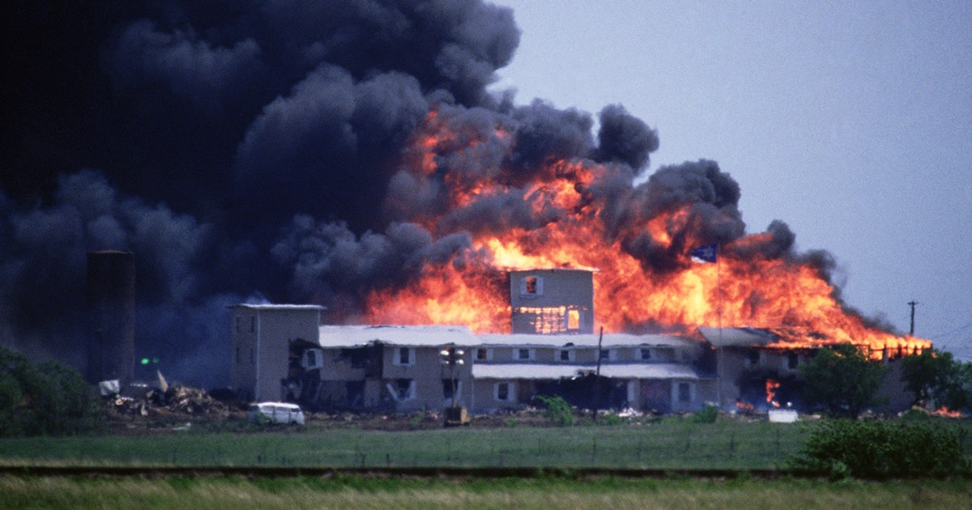
Growing in Holiness
2 PETER
Branch Davidian
David Koresh
Letting Loose of the Hope of Christ’s Coming
Notes:
David Koresh (Vernon Wayne Howell) was an American cult leader of the Branch Davidians sect, claiming to be its final prophet. Koresh, after Cyrus the Great, believed he was a Messianic type savior. By taking the name David he was “professing himself to be the spiritual descendant of King David, carrying out a divinely commissioned task of bring in the kingdom. One former member claimed that he fathered at least 15 children with various women. It is also claimed that Koresh would annul all marriages of couples who joined the group and had exclusive sexual access to the women. A raid by ATF agents on the Mount Carmel Center occurred enforcing a warrant on illegal weapons possession in which several ATF agents were killed. In the end Koresh and 79 followers perished after the compound went up in a blaze after a 51 day standoff with FBI agents. There destruction was swift.

Slide 10
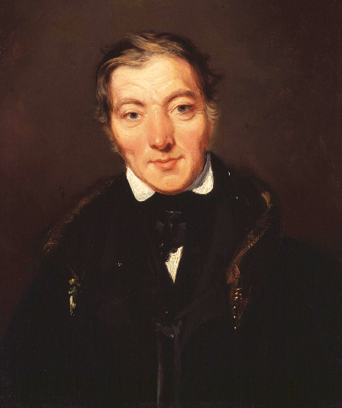


Growing in Holiness
2 PETER
Letting Loose of the Hope of Christ’s Coming
Notes:
Now what all these leaders represent are false teachers who did not hold fast to the hope of Christ’s Coming. But in one way or another are true life examples of false teachers spoken about in Peter’s second letter who brought destruction upon themselves and those who followed them. Many of them were “especially those who walk according to the flesh in the lust of uncleanness… “ (2:10a)
These are extreme and obvious examples of false teachers who teach a license to sin. There are two extremes to false teaching on the one hand you have legalism, Catholicism being the prime example, and there are many others, some teach a lesser form of legalism, most preach at least some form of it. On the other extreme you have license, freedom to sin. Now the legalist accuse Free Grace of being of antinomian, free from the law and free to sin, which is a dishonest misrepresentation of our position, because the authentic Free Grace Gospel teaches godly living.

Slide 11
2 Peter 2:4-9
Notes:
Peter has warned his readers of the coming of false teachers who will lead many astray, but those false teachers will eventually be judged by God. This brings us to consider the way in which God dealt with hardened unrepentant sinners in the past. Verses 2:4-9 is one long sentence in the Greek text, climaxed with the words “the Lord knows how to…”in verse 9.
“For if God did not spare the angels who sinned, but cast them down to hell and delivered them into chains of darkness, to be reserved for judgment; and did not spare the ancient world, but saved Noah, one of eight people, a preacher of righteousness, bringing in the flood on the world of the ungodly; and turning the cities of Sodom and Gomorrah into ashes, condemned them to destruction, making them an example to those who afterward would live ungodly; and delivered righteous Lot, who was oppressed by the filthy conduct of the wicked (for that righteous man, dwelling among them, tormented his righteous soul from day to day by seeing and hearing their lawless deeds) — then the Lord knows how to deliver the godly out of temptations and to reserve the unjust under punishment for the day of judgment,” (2 Peter 2:4-9)

Slide 12
Growing in Holiness
2 PETER
Three Judgments
Angels that sinned are cast into a deep pit and placed in chains of darkness waiting final judgment.
The ungodly in Noah’s day are all destroyed in a great flood of the entire earth.
The cities of Sodom and Gomorrah are condemned to destruction and turned into ashes.
Notes:
I was wondering, why did Peter pick these particular examples to describe God judgment on the wicked? Peter was a disciple of whom? Jesus!
Peter received instruction from the Lord Himself. We do not have a direct record of Jesus discussing angels that sinned in the Gospels, but we know that John tells us that there were many other things Jesus said that are not written. So it is possible, even probably that Peter was taught about the angels that sinned. But we do have the words of Jesus concerning the judgment of the ungodly in Noah’s day and in Lot’s day in Luke 17:26-30.

Slide 13
Growing in Holiness
2 PETER
The Doom of False Teachers
“And as it was in the days of Noah, so it will be also in the days of the Son of Man: They ate, they drank, they married wives, they were given in marriage, until the day that Noah entered the ark, and the flood came and destroyed them all...”

Slide 14
Growing in Holiness
2 PETER
The Doom of False Teachers
“Likewise as it was also in the days of Lot: They ate, they drank, they bought, they sold, they planted, they built; but on the day that Lot went out of Sodom it rained fire and brimstone from heaven and destroyed them all. Even so will it be in the day when the Son of Man is revealed.” (Luke 17:26-30)
Notes:
Jesus compares the days just prior to the coming of the son of Man in judgment with the days just prior to destruction in the days Noah and Lot. What was happening? Life was going along as normal, eating, drink, buying, selling, planting crops, people were planning for the future--building homes they were planning to live in, marrying and given in marriage. No one expected that their world was coming to an end. But it did, but not without warning.
So it will be on the day the Son of Man is revealed and the great and terrifying day of God’s wrath will begin. We now all live in days just like the days of Noah and Lot just prior to coming destruction. Today could be the day.

Slide 15
Growing in Holiness
2 PETER
The Doom of False Teachers
God destroyed all of the ungodly in the days of Noah
God destroyed all of the ungodly in the days of Lot.
God will also destroy all of the ungodly in the days of the Son of Man, when He is revealed, at His Second Coming.
God will destroyed all of the false teachers.
Notes:
Peter intends to demonstrate that God will judge the false teachers and others who have sinned against Him and His Word. History gives verification of this truth.
The examples Peter uses are first of all from the Lord, and secondly they are based on historical facts. These are statements of fact, because the punishment of the wicked whether angels or men actually took place, is currently taking place and will take place. This is based on a tangible interpretation of the passages—using the historical—grammatical method of interpretation.
Only those who apply Greek philosophical notions and Platonist methods of interpretation, and even Christian mysticism, (things many Bible student learn in seminary), arrive at an intangible interpretation of these passages and as a result many deny that these events described by Jesus and Peter ever took place. They say, these are only “cunningly devised fables”.

Slide 16
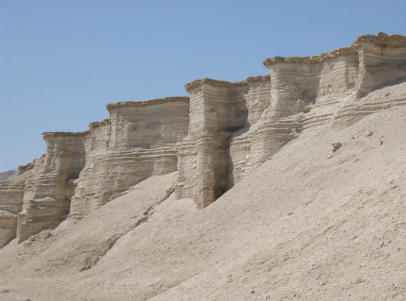
Growing in Holiness
2 PETER
The Doom of False Teachers
Angels, fallen angels/demons are a myth!
Noah and the global flood is a myth!
Sodom and Gomorrah is a myth!
Eternal punishment is a myth!
Christ Future Return is a myth!
Notes:
Angels and demons, including Satan himself is a myth. Their just characters in a story. Personifications of evil.
Noah and the a world wide flood that destroyed all of humanity except for eight people is a myth. Despite the fact there evidence of a global flood everywhere (Illustration: Dinosaur National Park)
Many say that the first 11 chapters of Genesis is myth. The Pastor’s wife, Mrs. Caldwell, said the story of Adam and Eve was a story made up by male chauvinistic rabbis who wanted to explain why women should be submissive to men. Another pastor who had a seminary degree from the Southern Baptist Seminary in Louisville told me that Moses could not have written the books of the Law, because writing had not been invented yet. Which untrue, disproven, totally made up.
The destruction of Sodom and Gomorrah is a myth. False teachers say God did not destroy them because of gross immorality—homosexuality, but for the lack of hospitality.
Eternal punishment is a myth. In a website called, “Here a little, there a little” Bryan T. Huie, May 9, 2003 said, “The common beliefs about living "eternal life" in heaven or suffering "everlasting punishment" in hell are myths built on speculation and tradition, NOT Scripture.”
But there is no allegorical, spiritual, parabolic or apocalyptic language in these verses.
The false teachers say Christ future return establishing and earthly kingdom on earth for 1000 years, regathering and restoring Israel, destroying their enemies, punishing the ungodly and rescuing the righteous, His Church from the day of God’s wrath by gathering them and snatching them up to a place of safety is nothing more than a cunningly devised fable as well, a myth, it is a result of “Wrongly Dividing the Word of Truth”. A critic of the futurist view even wrote a book by that title.
By the way, you know that discussion of eternal judgment is an elementary principle of Christ (Heb. 6:1) It the ABC’s of theology. If you don’t know it then you will need to learn it before you can advance in further.

Slide 17
Growing in Holiness
2 PETER
The Doom of False Teachers
Judgment Example #1
“For if God did not spare the angels who sinned, but cast them down to hell and delivered them into chains of darkness, to be reserved for judgment;” (2:4)
Notes:
God did not spare the angels that sinned of punishment. The nature of their sin is not clear. In Peter’s first letter he tells us they are spirits who disobey long ago. In Jude’s account he says the angels, “did not keep their proper domain, but left their own abode.” (Jude 6a) Their sin maybe in some way like the false teachers who lead men astray into vile sin. As a result they are cast into a deep pit, secured there until the day they are then cast into the lake of fire Rev. 20:10) They are “reserved in everlasting chains under darkness for the judgment of the great day.” (Jude 6b)
This is a argument from the greater to the lesser. If God did not spare the angels who beheld his glory in heaven, but cast them into this deep pit, will he not also punish teachers who are bent on leading people astray?

Slide 18
Growing in Holiness
2 PETER
The Doom of False Teachers
Judgment Example #2
“and did not spare the ancient world,… bringing in the flood on the world of the ungodly; (2:5a,c)
Notes:
Do false teachers think that they can escape the judgment of God because they are large in number? Think again. God will judge evil, even when it involves the entire human race. “bringing” suggests the suddenness of God’s judgment in the flood. Peter uses the same verb as in verse 1 of the false teachers who are “bringing” destruction on themselves.
The “ungodly” were people in which “every intent of the thoughts of his heart was only evil continually.” (Gen 6:5) So the Lord said, "I will destroy man whom I have created from the face of the earth…” (6:7a)

Slide 19
Growing in Holiness
2 PETER
The Doom of False Teachers
Judgment Example #3
“and turning the cities of Sodom and Gomorrah into ashes, condemned them to destruction, making them an example to those who afterward would live ungodly;” (2:6)
Notes:
These chief cities were known for their wickedness, especially homosexuality. Actually God destroyed the entire region, also destroying four additional cities. By means of natural causes he permanently devastated the whole plain of the Jordon. God destroy all living beings in the plane with burning sulphur (Gen. 19:24). They are a classic example of universal destruction of the ungodly (Gen. 10:15-29). The prophets Isaiah, Jeremiah, Ezekiel, Hosea, and Amos also cite Sodom and Gomorrah as an example of God’s anger against sin. Even Jesus compares the destiny of these cities to the doom that awaits the unbeliever. [Kistemaker, p. 289]

Slide 20
Growing in Holiness
2 PETER
The Doom of False Teachers
Rescue Example #1
“but saved Noah, one of eight people, a preacher of righteousness,” (2:5b)
Notes:
God protected Noah and his family from destruction by removing them to the ark that floated above it all.

Slide 21
Growing in Holiness
2 PETER
The Doom of False Teachers
Rescue Example #2
“and delivered righteous Lot, who was oppressed by the filthy conduct of the wicked (for that righteous man, dwelling among them, tormented his righteous soul from day to day by seeing and hearing their lawless deeds),” (2:7-8)
Notes:
God rescued Lot and His family as well. God sent two angels to lead then out of the cities just prior to their destruction again removing them to a place of safety away from the destruction (Gen. 19:16) Four left the cities, but Lot’s wife turn back and was turn to salt. But Lot and his two daughters were delivered.
Jude mentions another rescue and judgment in Jude 5, “But I want to remind you, though you once knew this, that the Lord, having saved the people out of the land of Egypt, afterward destroyed those who did not believe.”

Slide 22
Growing in Holiness
2 PETER
The Doom of False Teachers
Future Rescue
Jesus will delivers us “from the wrath to come”. (1 Thessalonians 1:10) removing us to a place of safety away from the destruction when the judgment begins to fall.
Notes:
In the eschatological framework in which Peter is working from, he is saying to his readers and to us, like righteous Noah and righteous Lot before us, Jesus will delivers us “from the wrath to come, removing us to a place of safety away from the destruction before the judgment begins to fall.

Slide 23
Growing in Holiness
2 PETER
The Doom of False Teachers
Future Rescue
“For you yourselves know perfectly that the day of the Lord so comes as a thief in the night.” (1 Thess. 5:2; 2 Peter 3:10)
Notes:
“For you yourselves know perfectly that the day of the Lord so comes as a thief in the night” (1 Thess. 5:2; 2 Peter 3:10) These are the only two verses in the NT that describe the day of Lord as coming “in the night”. Both Paul and Peter are teaching us the church is going to be rescued from the entire end-time period know as the day of the Lord.
Why do thieves come at night? So they are not seen. Even though you did not see them, you know that they were there when you discover some of your things are missing. So when Jesus comes to remove the church from the earth to the safety in the sky the world will not have seen Him, but they will know He came because something will be missing—the Church.
Like Lot we are distressed by the ungodliness of the false teachers or the world around us. But that distressed will not last forever. We can find hope in the His precious promise that our Savior will return soon and deliver us from the wrath to come, that could occur at any moment. Jesus said, “I will come upon you as a thief, and you will not know what hour I will come upon you.” (Rev 3:3) "Behold, I am coming as a thief. Blessed is he who watches.” (Rev 16:15)

Slide 24
Growing in Holiness
2 PETER
The Doom of False Teachers
If God sent judgment on the angel who sinned,
And if He judged the world of Noah’s day,
If He also overthrew Sodom and Gomorrah,
But if He saved Noah and delivered Lot,
Then it follows that,
Notes:
Here is a basic outline of what we just learned…

Slide 25
Growing in Holiness
2 PETER
The Doom of False Teachers
Conclusion
“then the Lord knows how to deliver the godly out of temptations/trials and to reserve the unjust under punishment for the day of judgment,” (2:9)

Slide 26
Growing in Holiness
2 PETER
The Doom of False Teachers
Conclusion #1
“then the Lord knows how to deliver the godly out of temptations/trials…” (2:9a)
Notes:
Conclusion is God knows how to deliver the godly from catastrophic disaster. If God knew how to do it for Noah’s family and for Lot’s family, he will know how to do it for us.
We have the precious promise from our Lord “I also will keep you from the hour of trial which shall come upon the whole world, to test those who dwell on the earth.” (Rev 3:10-11)
But when? "But of that day and hour no one knows…” What day? The day of the Lord. The day of God’s wrath. “Watch therefore, for you do not know what hour your Lord is coming.” (Matt:36; 42)

Slide 27
Growing in Holiness
2 PETER
The Doom of False Teachers
Conclusion #2
“and to reserve the unjust under punishment for the day of judgment,” (2:b)
Notes:
God also knows how to deal with the ungodly. We learn two truths here. Those who have perished from the earth and have not believed in Jesus for eternal life are presently in their intermediate state presently undergoing punishment while they wait and anticipate in the future a day of judgment for all sinful creatures whether men or fallen angels at the great white throne judgment of God. The nature or the severity is unclear. But the fact remains.
How blessed are we who have believed in the Lord Jesus Christ for eternal life.

Slide 28
Growing in Holiness
2 PETER
The Doom of False Teachers
Conclusion
This verses reminds us that we need to consider both “the goodness and severity of God…” (Rom. 11:22)

Slide 29

Growing in Holiness
2 PETER
Conclusion
Hold Fast to the Hope of Christ’s Coming
Notes:
The teachers who advocate a self-indulgent lifestyle mark by immorality pose a serious threat to the Church. They are the Lord’s enemies. The theological premise that underlines the their teaching is a rejection of the Second Coming to Christ to rescue the righteous, judge the wicked, and to establish a eternal kingdom mark by righteousness. If this doctrine is nothing more than “cunningly devise fable or myth” then Christians will not find in it “precious promises” that is going to motivate them to godly living and help them escape “the corruption that is in the world”. The loss of a real and vibrant hope in the establishment of kingdom in which only righteous well dwell will be lost and deal a serious blow to laying a strong foundation of true Christian morality.
Peter is telling us to Hold Fast the Hope of Christ’s Coming—it is a certainty based on reliable eyewitness testimony and based on reliable prophetic prophecy. Don’t fall for these pseudo teachers with their corrupt message and corrupt lifestyle.
Opposition to the message of the hope of Christ’s Coming is here and with it the danger of falling victim to their corruption. If we are to overcome the corruption of this world and the false teachers and grow in holiness we must stand firm in the hope of Christ’s coming! When we stand firm in a deep confidence in the reality of direct, inspired prophecy of God, we gain full-hearted confidence in the expectation of the Savior’s soon return.

